Slide 1

ABP Community Talks 2022.3 DDD, EventHub & the ABP Book

Slide 2
INTRODUCTION

Slide 3

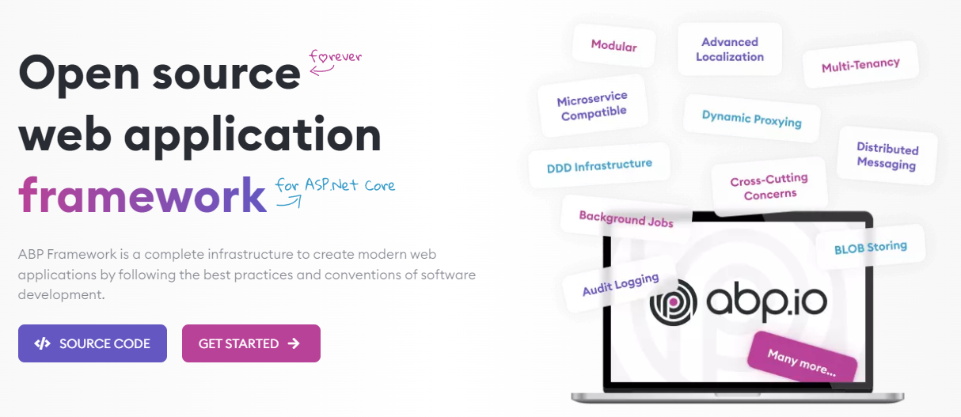
The ABP FRAMEWORK project https://abp.io --- https://github.com/abpframework

Slide 4
ABP Framework: Architecture
Domain Driven Design
& Layered Solution
Modular
Multi-Tenancy (SaaS infrastructure)
Microservice ready

Slide 5
ABP Framework: Infrastructure Enterprise application requirements
Cross-cutting concerns
Authentication & authorization
Distributed event bus
Audit logging
Background jobs
Data filtering & soft-delete
Dynamic client-side proxies
Dynamic forms
…more

Slide 6
ABP Framework: Startup templates

Slide 7
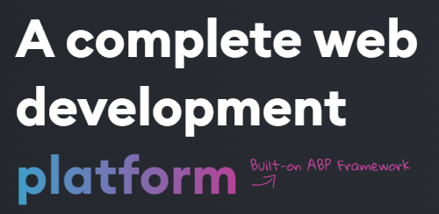
The ABP Commercial https://commercial.abp.io
Based on the ABP Framework:
Pro application modules
More pre-built application modules
Advanced UI themes
Code generation tooling
Microservice startup template
Premium support

Slide 8
Title
TODO: ...

Slide 9
Title
TODO: ...

Slide 10
DESIGNING A MODULAR MONOLITH
DESIGNING MONOLITH FIRST FOR MICROSERVICE ARCHITECTURE

Slide 11
Title
TODO: ...

Slide 12
Title
TODO: ...

Slide 13
Title
TODO: ...

